Slide 1


Eclipse EMF
Trainer name
City and date

Slide 2
About me: Ralf Ebert
Professional Java developer for 5 years
Primarily specializing in client-side development
    Web Applications
    Rich client applications
    Human-Computer Interaction and UI design
Consulting for a large German trading group:
Swing to Eclipse RCP migration project
User of Eclipse IDE for 4 years
ebert@weiglewilczek.com

Slide 3
About me: Ilya Shinkarenko
Software engineer / Consultant at Weigle Wilczek GmbH
      Java EE, Eclipse
      HCI, Usability
10 years of professional development
      Sun Certified Java Programmer
      Certified JBoss Developer
3+ years of Eclipse development
      >10 Eclipse-based projects
      Workshops, Seminars, Consulting
      Eclipse RCP Training concept
shinkarenko@weiglewilczek.com

Slide 4
About me: Alexander Thurow
Training / Coaching
Software engineer at Weigle Wilczek GmbH
6 years of Java development
    JEE on JBoss AS
4 years of Eclipse IDE
2 years of Eclipse RCP development
    Involved in 3 ongoing RCP projects
thurow@weiglewilczek.com

Slide 5
About me: Aleksey Aristov
Senior Software Architect at Weigle Wilczek GmbH
    Java EE, Eclipse
    C++
10+ years of professional development
    Certified Java Programmer for the Java 2 Platform
    Certified JBoss Consultant
    Certified Scrum Master
5+ years of professional Eclipse development
    >15 Eclipse-based projects
    Workshops, Seminars, Consulting
aristov@weiglewilczek.com

Slide 6
About me: Patrick Menard
Professional Java developer for 4 years
Focused on human interface design
Primarily specialized on
    Web Applications
    Rich client applications
User of Eclipse IDE for 1 year
menard@weiglewilczek.com

Slide 7
The Eclipse Training Alliance
» Founded December 2005 by WeigleWilczek and Innoopract
» WeigleWilczek now drives the initiative
with Innoopract as premium partner.
» Goals:
» International one-stop offer of high quality Eclipse training classes
» Certificates
» Coaching and consulting
» Focus instructor-led classroom instruction
and in-depth hands-on labs and tutorials
» We share expertise.

Slide 8







Partners of the Eclipse Training Alliance
Founder of the Eclipse Training Alliance (worldwide)
Maker of Eclipse distribution Yoxoy (Germany; USA)
France, Spain
Benelux
Switzerland
Scandinavia
China

Slide 9
Training classes of the Eclipse Training Alliance
Eclipse RCP
Enterprise Applications with Eclipse RCP
Effective Usage of the Eclipse IDE
Eclipse EMF, GEF and GMF
Professional web Development with RAP
Lotus Notes 8 and Eclipse RCP
Legal Introduction to Open Sourse Licensing
Upcomming Training classes:
  Agility with Eclipse and Mylin (already available in NL)
  BIRT (already available in CH and USA

Slide 10
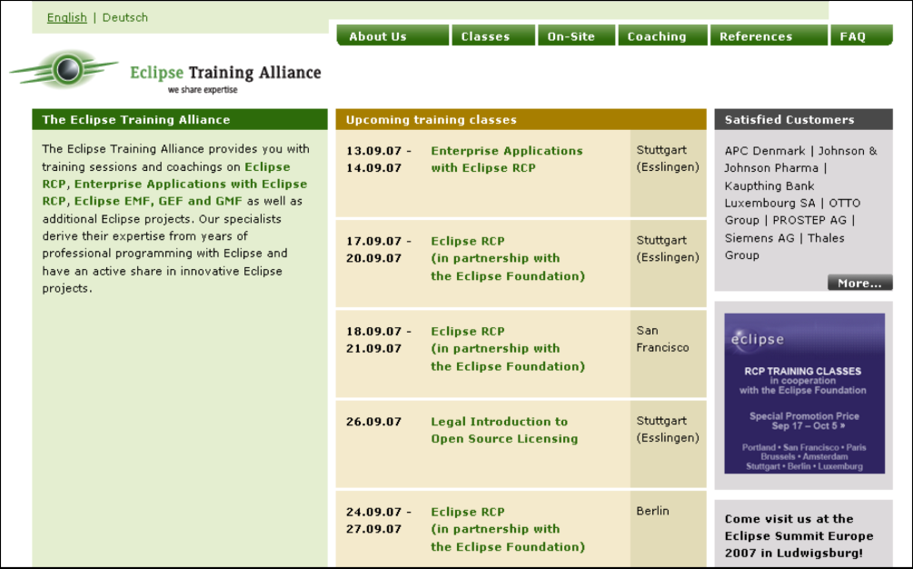
Eclipse Training Alliance: contact Europe
Please contact us for details:
Eclipse Training Alliance
c/o Weigle Wilczek GmbH
Dr. Jörn Weigle
Martinstraße 42-44
D-73728 Esslingen
Phone (+49) 711 45 99 98 0
Fax (+49) 711 45 99 98 29
www.eclipse-training.net

Slide 11

Eclipse Training Alliance: contact USA
Please contact us for details:
Eclipse Training Alliance
c/o Innoopract Inc.
Sanna Kaldner
351 NW 12th Avenue
Portland, OR 97 209
Phone (+1) 888 679 8753
e-mail skaldner@innoopract.com
www.eclipse-training.net

Slide 12
Who is everybody?
Java experience?
GUI programming with Swing/ AWT?
Experience with Eclipse as IDE?
Experience with Eclipse as a platform for riche client applications?
Other technical background?

Slide 13
Training philosophy
We teach the basic concepts and patterns
» Almost everything is learned by practice: "learning by doing"
» Approximately 40% theory, 60% practice
» Use Eclipse sources as an example
» Learn to work effectively in Eclipse IDE (shortcuts, tips & tricks)
» There are no stupid questions!

Slide 14
What is EMF?
A modeling & data integration framework
Exploits the facilities offered in Eclipse to…
  Generate code without losing user customizations (merge)
  Automate important tasks (such as registering the runtime information)
  Improve extensibility
  Provide a UI layer
What is an EMF “model”?
  Specification of your application’s data
    Object attributes
    Relationships (associations) between objects
    Operations available on each object
    Simple constraints (eg. cardinality) on objects and relationships
  Essentially it represents the class diagram of the application

Slide 15
What does EMF Provide?
From a model specification, EMF can generate efficient, correct, and easily customizable implementation code
Out of the box, EMF provides support for
  Java™ interfaces
  UML
  XML Schema
EMF converts your models to Ecore (EMF metamodel)
Tooling support within the Eclipse framework (UI, headless mode, Ant and standalone), including support for generating Eclipse-based and RCP editors
Reflective API and dynamic model definition
Persistence API with out of box support for XML/XMI (de)serialization of instances of a model
And much more….

Slide 16
Why EMF?
EMF is middle ground in the modeling vs. programming worlds
  Focus is on class diagram subset of UML modeling (object model)
  Transforms models into Java code
  Provides the infrastructure to use models effectively in your application
Very low cost of entry
  EMF is free and open source
  Full scale graphical modeling tool not required
  Reuses your knowledge of UML, XML Schema, or Java
It’s real, proven technology (since 2002)

Slide 17
EMF History
First version was released in June, 2002
Originally based on MOF (Meta Object Facility)
  From OMG (Object Management Group)
  Abstract language and framework for specifying, constructing, and managing technology neutral metamodels
EMF evolved based on experience supporting a large set of tools
  Efficient Java implementation of a practical subset of the MOF API
2003: EMOF defined (Essential MOF)
  Part of OMG’s MOF 2 specification; UML2 based
  EMF is approximately the same functionality
    Significant contributor to the spec; adapting to it

Slide 18
Creating the Ecore Model
Representing the modeled domain in Ecore is the first step in using EMF
Ecore can be created
  Directly using the EMF editors
  Through a graphical UI provided by external contributions
  By converting a model specification for which a Model Importer is available
Model Importers available in EMF
  Java Interfaces
  UML models expressed in Rational Rose® files
  XML Schema
Choose the one matching your perspective or skills

Slide 19
Model Importers Available in EMF
Java Interfaces
public interface PurchaseOrder
{
String getShipTo();
void setShipTo(String value);
String getBillTo();
void setBillTo(String value);
List<Item> getItems();
}
public interface Item
{
String getProductName();
void setProductName(String value);
int getQuantity();
void setQuantity(int value)
float getPrice();
void setPrice(float value);
}

Slide 20
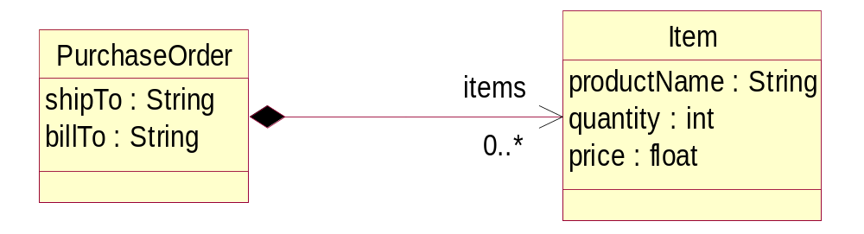
Model Importers Available in EMF
UML Class Diagram

Slide 21
Model Importers Available in EMF
XML Schema
<?xml version="1.0" encoding="UTF-8"?>
<xsd:schema xmlns:xsd="http://www.w3.org/2001/XMLSchema"
targetNamespace="http://www.example.com/SimplePO"
xmlns:PO="http://www.example.com/SimplePO">
<xsd:complexType name="PurchaseOrder">
<xsd:sequence>
<xsd:element name="shipTo" type="xsd:string"/>
<xsd:element name="billTo" type="xsd:string"/>
<xsd:element name="items" type="PO:Item"
minOccurs="0" maxOccurs="unbounded"/>
</xsd:sequence>
</xsd:complexType>
<xsd:complexType name="Item">
<xsd:sequence>
<xsd:element name="productName" type="xsd:string"/>
<xsd:element name="quantity" type="xsd:int"/>
<xsd:element name="price" type="xsd:float"/>
</xsd:sequence>
</xsd:complexType>
</xsd:schema>

Slide 22
Unifying Java, XML and UML Technologies
The Model Importers available in EMF were carefully chosen to integrate today’s most important technologies
All three forms provide the same information
  Different visualization/representation
  The application’s “model” of the structure
From a model definition, EMF can generate
  Java implementation code, including UI
  XML Schemas
  Eclipse projects and plug-in

Slide 23
Typical EMF Usage Scenario
Create an Ecore model that represents the domain you are working on
  Import UML (e.g. Rose .mdl file)
  Import XML Schema
  Import annotated Java interfaces
  Create Ecore model directly using EMF's Ecore editor or a graphical editor
Generate Java code for model
Prime the model with instance data using generated EMF model editor
Iteratively refine model (and regenerate code) and develop Java application
  You will use the EMF generated code to implement the use cases of your application
Optionally, use EMF.Edit to build customized user interface

Slide 24
EMF and Java 5.0
EMF 2.3 exploits the capabilities of Java 5.0
  Generics
  Typesafe enums
  Annotations
  Enhanced for loop
  Autoboxing
EMF 2.3 provides a 5.0-targeted runtime that can only be run on a Java 5.0 or later VM
The code generator can also produce application code that runs on a 1.4 VM against the EMF 2.2.x runtime
This is a recognition that Java 5.0 is the way forward, but the transition need not be painful for the user

Slide 25
Agenda
EMF Components
The Ecore Metamodel
Code Generation, Regeneration and Merge
The EMF Runtime
Recording Changes
Validation
Eclipse Modeling Framework Technology Project
Advanced topics

Slide 26
EMF Architecture
Application
Model
Editor
EMF Tools
Codegen
Generates
EMF Runtime
Core
Edit
Eclipse Platform

Slide 27
EMF Components
EMF Core
  Ecore metamodel
  Model change notification & validation
  Persistence and serialization
  Reflection API
  Runtime support for generated models
EMF Edit
  Helps integrate models with a rich user interface
  Used to build editors and viewers for your model
  Includes default reflective model editor
EMF Codegen
  Code generator for core and edit based components
  Extensible model importer/exporter framework

Slide 28
EMF Tools: Model Import and Generation
I
M
P
O
R
T
Ecore
Model
Generator Features:
Customizable JSP-like templates (JET)
JDT-integrated, command-line, or Ant
Fully supports regeneration and merge
UML
GENERATE
XML
Schema
Java
model
Java
model
Java
edit
Java
editor*
* Eclipse IDE-integrated or RCP-based

Slide 29
EMF Model Importers
UML
  Rational Rose .mdl file
  Eclipse UML2 project provides importer for .uml2
Annotated Java
  Java interfaces representing modeled classes
  Javadoc annotations using @model tags to express model properties not captured by method declarations
  Lowest cost approach
XML Schema
  Describes the data of the modeled domain
  Provides richer description of the data, which EMF exploits
Ecore model (*.ecore file)
  Just creates the generator model (discussed later)
  Also handles EMOF (*.emof)

Slide 30
Ecore Model Creation
An Ecore model is created within an Eclipse project via a wizard
Input: one of the model specifications from the previous slide
Output:
  modelname.ecore
    Ecore model file in XMI format
    Canonical form of the model
  modelname.genmodel
    A “generator model” for specifying generator options
    Contains decorators for Ecore model elements, providing details that would otherwise pollute the model (e.g. target directories for code generation)
    EMF code generator is an EMF .genmodel editor
    Automatically kept in synch with .ecore file

Slide 31
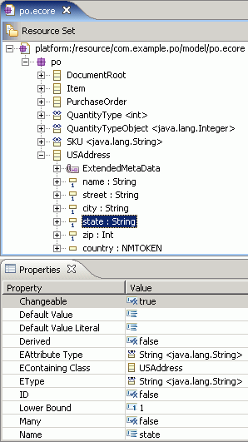
Ecore Model Editor
A generated (and customized) EMF editor for the Ecore model
Create, delete, etc. model elements (EClass, EAttribute, EReference, etc.) using pop-up actions in the editor's tree
Set names, etc. in the Properties view

Slide 32
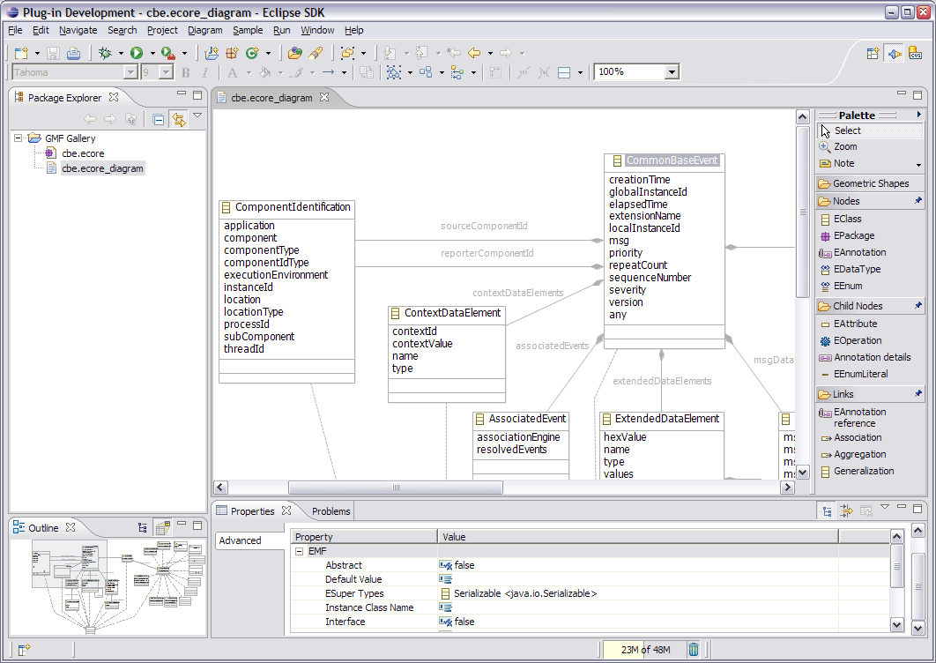
Ecore Model Editor
A graphical editor is a better approach
  GMF Ecore Diagram Example (http://www.eclipse.org/gmf/)
  Omondo EclipseUML (http://www.omondo.com/)

Slide 33
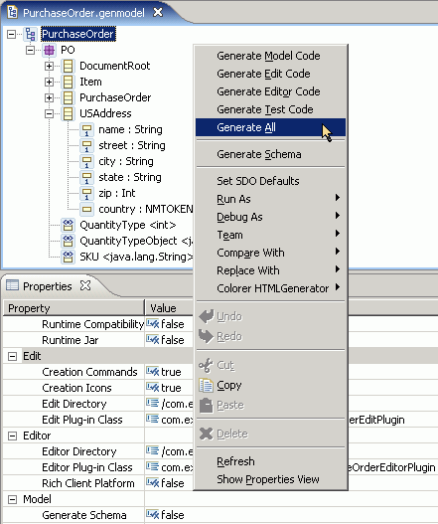
EMF Generator
Similar layout to Ecore model editor
Automatically keeps in synch with .ecore changes
Generate code with pop-up menu actions
  Generate Model Code
  Generate Edit Code
  Generate Editor Code
  Generate Test Code
  Generate All
Code generation options in Properties view
Generator > Reload to reload .genmodel and .ecore files from original model form

Slide 34
Agenda
EMF Components
The Ecore Metamodel
Code Generation, Regeneration and Merge
The EMF Runtime
Recording Changes
Validation
Eclipse Modeling Framework Technology Project
Advanced topics

Slide 35
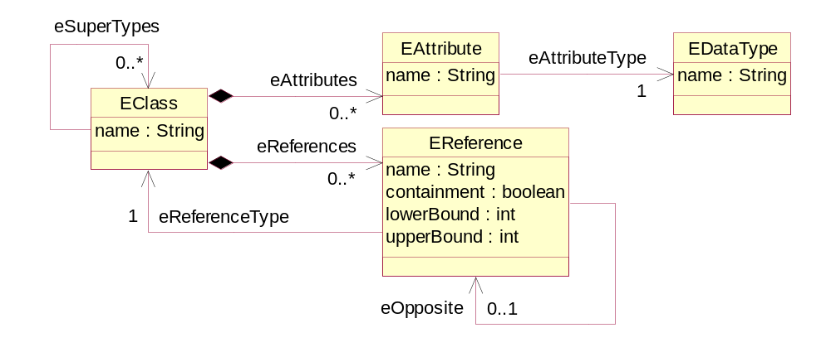
The Ecore (Meta) Model
Ecore is EMF's model of a model
  Also called a “metamodel”
  Persistent representation is XMI

Slide 36
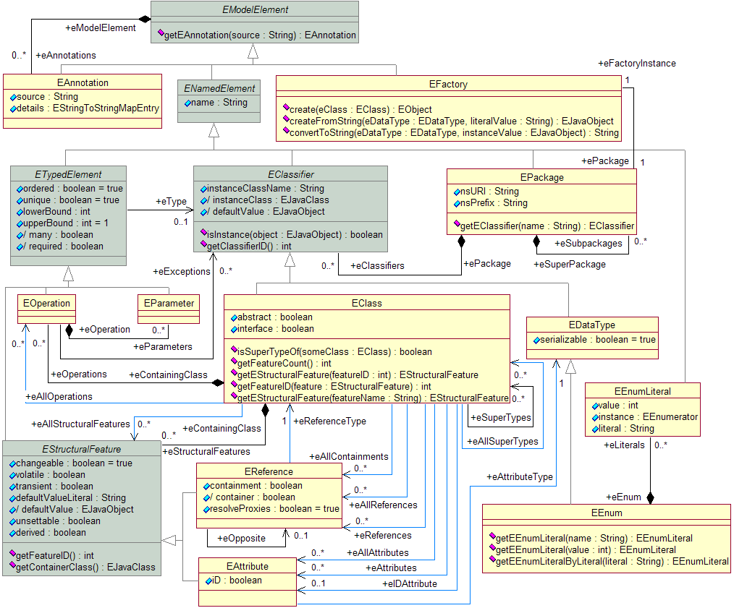
The Ecore Metamodel

Slide 37
Partial List of Ecore Data Types
Ecore data types are serializable and custom data types are supported
Ecore Data Type
Java Primitive Type or Class
EBoolean
boolean
EChar
char
EFloat
float
EString
java.lang.String
EByteArray
byte[ ]
EBooleanObject
java.lang.Boolean
EFloatObject
java.lang.Float
EJavaObject
java.lang.Object

Slide 38
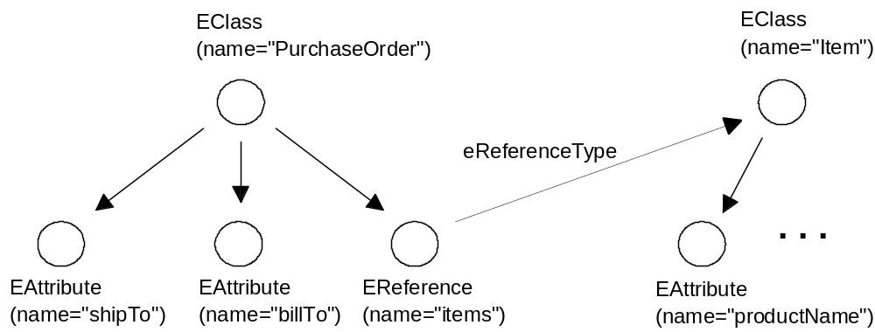
Ecore Model for Purchase Orders
is represented in Ecore as

Slide 39
Purchase Order Ecore XMI
Alternate serialization format is EMOF (Essential MOF) XMI
  Part of OMG Meta Object Facility (MOF) 2.0 standard (http://www.omg.org/docs/ptc/04-10-15.pdf)
<eClassifiers xsi:type="ecore:EClass"
name="PurchaseOrder">
<eReferences name="items" eType="#//Item"
upperBound="-1" containment="true"/>
<eAttributes name="shipTo"
eType="ecore:EDataType http:...Ecore#//EString"/>
<eAttributes name="billTo"
eType="ecore:EDataType http:...Ecore#//EString"/>
</eClassifiers>

Slide 40
Agenda
EMF Components
The Ecore Metamodel
Code Generation, Regeneration and Merge
The EMF Runtime
Recording Changes
Validation
Eclipse Modeling Framework Technology Project
Advanced topics

Slide 41
Code Generation
EMF framework is lightweight
  Generated code is clean, simple, efficient
EMF can generate
  Model implementation
  UI-independent edit support
  Editor and views for Eclipse IDE-integrated or RCP application
  JUnit test skeletons
  Manifests, plug-in classes, properties, icons, etc.

Slide 42
Generated Model Code
Interface and implementation for each modeled class
  Includes get/set accessors for attributes and references
  Usage example
public interface PurchaseOrder extends EObject
{
String getShipTo();
void setShipTo(String value);
String getBillTo();
void setBillTo(String value);
EList<Item> getItems();
}
order.getItems().add(item);

Slide 43
Generated Model Code
Factory to create instances of model objects
Package class provides access to metadata
Also generated: switch utility, adapter factory base, validator, custom resource, XML processor
POFactory factory = POFactory.eINSTANCE;
PurchaseOrder order = factory.createPurchaseOrder();
POPackage poPackage = POPackage.eINSTANCE;
EClass itemClass = poPackage.getItem();
//or POPackage.Literals.ITEM
EAttribute priceAttr = poPackage.getItem_Price();
//or itemClass.getEStructuralFeature(POPackage.ITEM__PRICE)
//or POPackage.Literals.ITEM__PRICE

Slide 44
Generated Edit/Editor Code
Viewing/editing code divided into two parts
  UI-independent code
    Item providers (adapters)
    Item provider adapter factory
  UI-dependent code
    Model creation wizard
    Editor
    Action bar contributor
    Advisor (RCP)
  By default each part is placed in a separate Eclipse plug-in

Slide 45
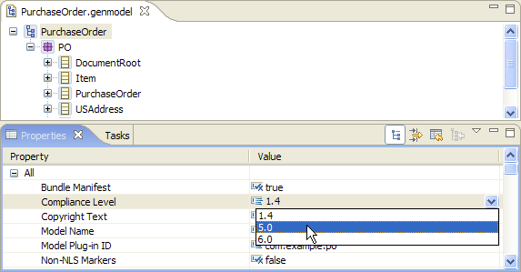
Java 5.0 Constructs
For a new model, EMF 2.3 targets the compiler compliance level specified by the containing project (or the workspace default)
To generate code with Java 5.0 constructs for an existing model, use the “Compliance Level” property on the GenModel
Notes:
You will also need to:
- manually change the JDK compliance level in the Java Compiler project properties or workspace preferences
- Update the JRE container in the project’s classpath (use the Plug-in Manifest Editor: on the overview page, select “Update the classpath settings”)

Slide 46
Summary of Generated Artifacts
Model
  Interfaces and classes
  Type-safe enumerations
  Package (metadata)
  Factory
  Switch utility
  Adapter factory base
  Validator
  Custom resource
  XML Processor
Edit (UI independent)
  Item providers
  Item provider adapter factory
Editor
  Model Wizard
  Editor
  Action bar contributor
  Advisor (RCP)
Tests
  Test cases
  Test suite
  Stand-alone example
Manifests, plug-in classes, properties, icons...

Slide 47
Regeneration and Merge
Hand-written code can be added to generated code and preserved during regeneration
  This merge capability has an Eclipse dependency, so is not available standalone
All generated classes, interfaces, methods and fields include @generated marker in their Javadoc
To replace generated code:
  Remove @generated marker
  Or include additional text, e.g.
    @generated NOT
Methods without @generated marker are left alone during regeneration

Slide 48
Regeneration and Merge
Extend (vs. replace) generated method through redirection
  Append “Gen” suffix to the generated method's name
/**
* <!-- begin-user-doc -->
* <!-- end-user-doc -->
* @generated
*/
public String getName()
{
return name;
}
/**
* <!-- begin-user-doc -->
* <!-- end-user-doc -->
* @generated
*/
public String getNameGen()
{
return name;
}
public String getName()
{
return format(getNameGen());
}

Slide 49
The Code Generation Process
Ecore
Model Importer
GenModel
JET
UML
?
Java Code
Java Model
XML Schema
Simplified version

Slide 50
The Code Generation Process
Ecore
Model Importer
JET
Generated
Java Code
GenModel
JMerge
Java Code
UML
?
Java Model
XML Schema
Merged
Java Code
Full version

Slide 51
Agenda
EMF Components
The Ecore Metamodel
Code Generation, Regeneration and Merge
The EMF Runtime
Recording Changes
Validation
Eclipse Modeling Framework Technology Project
Advanced topics

Slide 52
EMF Runtime
Persistence and serialization of model data
  Proxy resolution and demand load
Automatic notification of model changes
Bi-directional reference handshaking
Dynamic object access through a reflective API
Runtime environments
  Eclipse
    Full IDE
    RCP
  Standalone Java

Slide 53
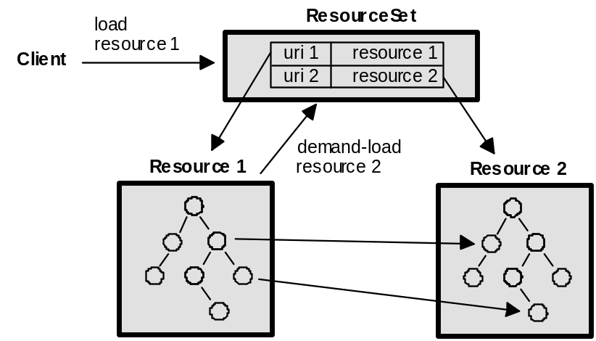
Persistence and Serialization
Serialized data is referred to as a resource
Data can be spread out among a number of resources in a resource set
One resource is loaded at a time, even if it has references to objects in other resources in the resource set
  Proxies exist for objects in other resources
  Lazy or demand loading of other resources as needed
  A resource can be unloaded

Slide 54
Uniform Resource Identifier (URI)
A formatted string that serves as an identifier for a resource
Specification:
  Definition: http://www.ietf.org/rfc/rfc1630.txt
  Generic Syntax: http://www.ietf.org/rfc/rfc2396.txt
Syntax:
  Generic
  [scheme:]scheme-specific-part[#fragment]
  Hierarchical
    [scheme:][//authority][path][?query][#fragment]
Used in EMF to identify a resource, an object in a resource, or an Ecore package (namespace URI)
Notes:
Formatted string: /, encoded, …
Encoding is done by
Converting the character string into a sequence of bytes using UTF-8
Convert each character that is not an ASCII letter or digit into %HH, where HH is the hexadecimal value of the byte
URL: Resources that can be accessed with existing protocols
URN: “Intended to serve as persistent, location-independent, resource identifiers”
oasis urn: http://rfc3121.x42.com/

Slide 55
Resource Set
Context for multiple resources that may have references among them
Usually just an instance of ResourceSetImpl, or a customized subclass
Provides factory method for creating new resources in the set:
Also provides access to the registries, URI converter, and default load options for the set
ResourceSet rs = new ResourceSetImpl();
URI uri = URI.createFileURI("C:/data/po.xml");
Resource resource = rs.createResource(uri);

Slide 56
Resource Factory Registry
Returns a resource factory for a given type of resource
  Based on the URI scheme or filename extension
  Determines the type of resource, hence format for save/load
For models created from XML Schema, the generated custom resource factory implementation should be registered to ensure schema-conformant serialization
  When running as a plug-in under Eclipse, EMF provides an extension point for registering resource factories
  Generated plugin.xml registers generated resource factory against a package specific extension (e.g. “po”)
Global registry: Resource.Factory.Registry.INSTANCE
  Consulted if no registered resource factory found locally
Resource.Factory.Registry reg = rs.getResourceFactoryRegistry();
reg.getExtensionToFactoryMap().put("xml", new XMLResourceFactoryImpl());

Slide 57
Package Registry
Returns the package identified by a given namespace URI
  Used during loading to access the factory for creating instances
Global registry: EPackage.Registry.INSTANCE
  Consulted if no registered package found locally
Running in Eclipse, EMF provides an extension point for globally registering generated packages
Even standalone, a package automatically registers itself when accessed:
EPackage.Registry registry = rs.getPackageRegistry();
registry.put(POPackage.eNS_URI, POPackage.eINSTANCE);
POPackage poPackage = POPackage.eINSTANCE;

Slide 58
Resource
Container for objects that are to be persisted together
  Convert to and from persistent form via save() and load()
  Access contents of resource via getContents()
EMF provides XMLResource implementation
Other, customized XML resource implementations, provided, too (e.g. XMI, Ecore, EMOF)
URI uri = URI.createFileURI("C:/data/po.xml");
Resource resource = rs.createResource(uri);
resource.getContents().add(p1);
resource.save(null);
<PurchaseOrder>
<shipTo>John Doe</shipTo>
<next>p2.xml#p2</next>
</PurchaseOrder>

Slide 59
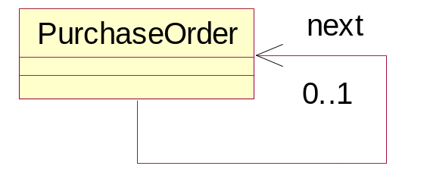
Proxy Resolution and Demand Load
p1.xml
<PurchaseOrder>
<shipTo>John Doe</shipTo>
<next>p2.xml#p2</next>
</PurchaseOrder>
p1.xml
p2.xml
next
p1
next
next
p2
proxyURI=“p2.xml#p2”
proxyURI=“p2.xml#p2”
PurchaseOrder p2 = p1.getNext();

Slide 60
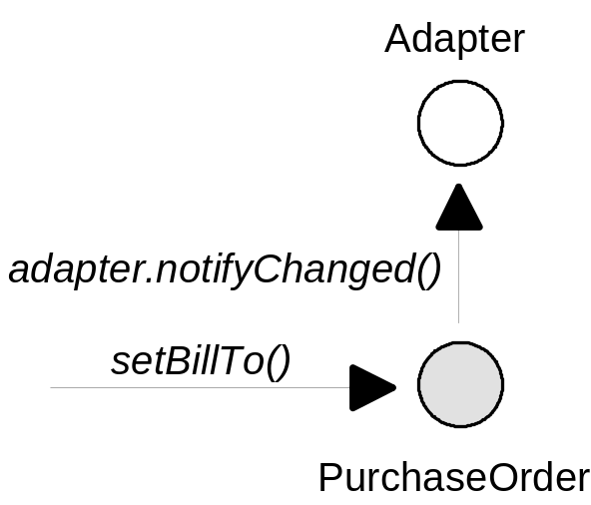
Model Change Notification
Every EMF object is also a Notifier
  Send notification whenever an attribute or reference is changed
  EMF objects can be “observed” in order to update views and dependent objects
Adapter poObserver = ...
purchaseOrder.eAdapters().add(poObserver);

Slide 61
Model Change Notification
Observers or listeners in EMF are called adapters
  An adapter can also extend class behavior without subclassing
  For this reason they are typically added using an AdapterFactory
PurchaseOrder purchaseOrder = ...
AdapterFactory somePOAdapterFactory = ...
Object poExtensionType = ...
if (somePOAdapterFactory.isFactoryForType(poExtensiontype))
{
Adapter poAdapter = somePOAdapterFactory.adapt(purchaseOrder,
poExtensionType);
...
}

Slide 62
Model Change Notification
Efficient notification in “set” methods
  Checks for listeners before creating and sending notification
public String getShipTo()
{
return shipTo;
}
public void setShipTo(String newShipTo)
{
String oldShipTo = shipTo;
shipTo = newShipTo;
if (eNotificationRequired())
eNotify(new ENotificationImpl(this, ... );
}

Slide 63
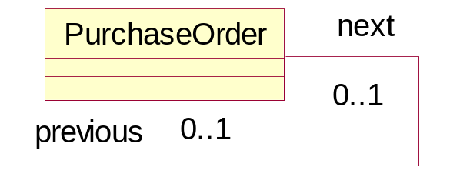
Bidirectional Reference Handshaking
Invariant imposed by the bidirectional reference:
po.getNext().getPrevious() == po
public interface PurchaseOrder
{
PurchaseOrder getNext();
void setNext(PurchaseOrder value);
PurchaseOrder getPrevious();
void setPrevious(PurchaseOrder value);
}

Slide 64
Bidirectional Reference Handshaking
next
next
next
p1
p2
next
p3
previous
previous
previous
change
notification
p2
previous
p1.setNext(p3);

Slide 65
Bidirectional Reference Handshaking
This multi-step procedure is implemented using InternalEObject methods:
  eInverseRemove()
  eInverseAdd()
Framework list implementations and generated setters directly invoke them on target objects as needed
Notifications are accumulated using a NotificationChain and fired off at the end
  They are not used to implement the handshaking

Slide 66
Reflection
All EMF classes implement interface EObject
Provides an efficient API for manipulating objects reflectively
  Used by the framework (e.g., serialization/deserialization, copy utility, generic editing commands, etc.)
  Also key to integrating tools and applications built using EMF
public interface EObject
{
EClass eClass();
Object eGet(EStructuralFeature sf);
void eSet(EStructuralFeature sf, Object val);
...
}

Slide 67
Reflection Example
Setting an attribute using generated API:
Using reflective API:
PurchaseOrder po = ...
po.setBillTo("123 Elm St.");
EObject po = ...
EClass poClass = po.eClass();
po.eSet(poClass.getEStructuralFeature("billTo"),
"123 Elm St.");

Slide 68
Reflective Performance
Efficient generated switch-based implementation of reflective methods
public Object eGet(int featureID, ...)
{
switch (featureID)
{
case POPackage.PURCHASE_ORDER__SHIP_TO:
return getShipTo();
case POPackage.PURCHASE_ORDER__BILL_TO:
return getBillTo();
...
}
}

Slide 69
Reflection Benefits
Reflection allows generic access to any EMF model
  Similar to Java’s introspection capability
  Every EObject (that is, every EMF object) implements the reflection API
An integrator need only know your model!
A generic EMF model editor uses the reflection API
  Can be used to edit any EMF model

Slide 70
Dynamic EMF
Ecore models can be defined dynamically in memory
  No generated code required
  Dynamic implementation of reflective EObject API provides same runtime behavior as generated code
  Also supports dynamic subclasses of generated classes
All EMF model instances, whether generated or dynamic, are treated the same by the framework
A dynamic Ecore model can be defined by
  Instantiating model elements with the Ecore API
  Loading from a .ecore file

Slide 71
Dynamic EMF Example
Model definition using the Ecore API
EPackage poPackage = EcoreFactory.eINSTANCE.createEPackage();
poPackage.setName("po");
poPackage.setNsURI("http://www.example.com/PurchaseOrder");
EClass poClass = EcoreFactory.eINSTANCE.createEClass();
poClass.setName("PurchaseOrder");
poPackage.getEClassifiers().add(poClass);
EAttribute billTo = EcoreFactory.eINSTANCE.createEAttribute();
billTo.setName("billTo");
billTo.setEType(EcorePackage.eINSTANCE.getEString());
poClass.getEStructuralFeatures().add(billTo);
...
EObject po = EcoreUtil.create(poClass);
po.eSet(billTo,"123 Elm St.");

Slide 72
Agenda
EMF Components
The Ecore Metamodel
Code Generation, Regeneration and Merge
The EMF Runtime
Recording Changes
Validation
Eclipse Modeling Framework Technology Project
Advanced topics

Slide 73
Recording Changes
EMF provides facilities for recording the changes made to instances of an Ecore model
Change Model
  An EMF model for representing changes to objects
  Directly references affected objects
  Includes “apply changes” capability
Change Recorder
  EMF adapter
  Monitors objects to produce a change description (an instance of the change model)

Slide 74
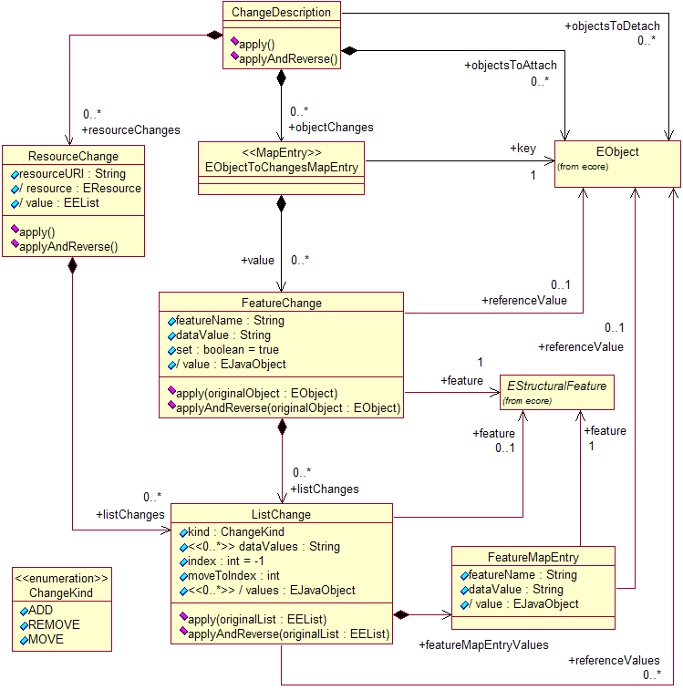
Change Model

Slide 75
Change Recorder
Can be attached to EObjects, Resources, and ResourceSets
  Monitors changes to the objects and their contents trees
Produces a description of the changes needed to return to the original state (a reverse delta)
Result: a change description with one change, setting billTo to “123 Elm St.”
PurchaseOrder order = ...
order.setBillTo("123 Elm St.");
ChangeRecorder recorder = new ChangeRecorder();
recorder.beginRecording(Collections.singleton(order));
order.setBillTo("456 Cherry St.");
ChangeDescription change = recorder.endRecording();

Slide 76
Applying Changes
Given a change description, the change can be applied:
  ChangeDescription.apply()
    consumes the changes, leaving the description empty
  ChangeDescription.applyAndReverse()
    reverses the changes, leaving a description of the changes originally made (the forward delta)
The model is always left in an appropriate state for applying the resulting change description

Slide 77
Example: Transaction Capability
If any part of the transaction fails, undo the changes
ChangeRecorder changeRecorder =
new ChangeRecorder(resourceSet);
try
{
// modifications within resource set
}
catch (Exception e)
{
changeRecorder.endRecording().apply();
}

Slide 78
Agenda
EMF Components
The Ecore Metamodel
Code Generation, Regeneration and Merge
The EMF Runtime
Recording Changes
Validation
Eclipse Modeling Framework Technology Project
  Validation
  Query
  Transaction
Advanced topics

Slide 79
Validation Framework
Model objects validated by external EValidator
Detailed results accumulated as Diagnostics
  Essentially a non-Eclipse equivalent to IStatus
  Records severity, source plug-in ID, status code, message, other arbitrary data, and nested children
public interface Evalidator
{
boolean validate(EObject eObject,
DiagnosticChain diagnostics, Map Context);
boolean validate(EClass eClass, EOjbect eObject,
DiagnosticChain, diagnostics, Map context);
boolean validate(EDataType eDataType, Object value,
DiagnosticChain diagnostics, Map context);
...
}

Slide 80
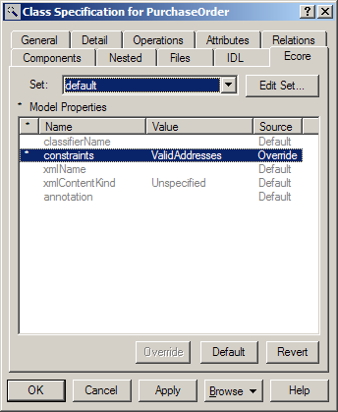
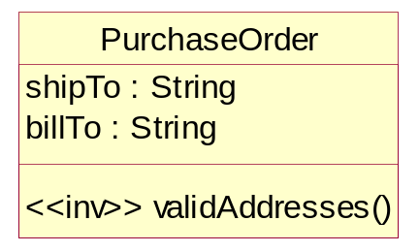
Invariants and Constraints
Invariant
  Defined directly on the class, as an operation with <<inv>> stereotype
  Stronger statement about validity than a constraint
Constraint
  Externally defined for the class via a method on the validator

Slide 81
Generated EValidator Implementations
Generated for each package that defines invariants or constraints
Dispatches validation to type-specific methods
For classes, a validate method is called for each invariant and constraint
  Method body must be hand coded for invariants and named constraints

Slide 82
Schema-Based Constraints
In XML Schema, named constraints are defined via annotations:
Also, constraints can be defined as facets on simple types, and no additional coding is required
  Constraint method implementation generated
<xsd:annotation>
<xsd:appinfo source="http://www.eclipse.org/emf/2002/Ecore"
ecore:key="constraints">VolumeDiscount</xsd:appinfo>
</xsd:annotation>
<xsd:simpleType name="SKU">
<xsd:restriction base="xsd:string">
<xsd:pattern value="\d{3}-[A-Z]{2}"/>
</xsd:restriction>
</xsd:simpleType>

Slide 83
Framework EValidator Implementations
EObjectValidator validates basic EObject constraints:
  Multiplicities are respected
  Proxies resolve
  All referenced objects are contained in a resource
  Data type values are valid
Used as base of generated validators and directly for packages without additional constraints defined

Slide 84
Framework EValidator Implementations
Diagnostician walks a containment tree of model objects, dispatching to package-specific validators
  Diagnostician.validate() is the usual entry point
  Obtains validators from its EValidator.Registry
Diagnostician validator = Diagnostician.INSTANCE;
Diagnostic diagnostic = validator.validate(order);
if (diagnostic.getSeverity() == Diagnostic.ERROR)
{
// handle error
}
for (Diagnostic child : diagnostic.getChildren())
{
// handle child diagnostic
}

Slide 85
Agenda
EMF Components
The Ecore Metamodel
Code Generation, Regeneration and Merge
The EMF Runtime
Recording Changes
Validation
Eclipse Modeling Framework Technology Project
  Validation
  Query
  Transaction
Advanced topics

Slide 86
What is EMFT?
A collection of components that “add on” to EMF to provide value-added capabilities for rich applications
Currently includes:
  Validation – a flexible framework for contributing 3rd-party constraints to model validation
  Query – an SQL-like Java API for querying EMF resources
  Transaction – a transaction protocol for concurrent access to EMF resources
  CDO, Teneo – object-relational mappings for persistence of EMF resources in RDBMSes
  JET Editor – a rich editor for JET templates

Slide 87
What does the Validation Framework Provide?
Extensibility:
  Constraint providers contribute constraints from any source they deem fit, including the plugin.xml, constraints embedded in models, or external models
  Constraint parsers contribute support for constraint specification languages. Out of the box, the framework implements Java and OCL support.
  Traversal strategies contribute knowledge of the model structure and how to discover its extent to validate it
  Constraint categories and bindings help to organize constraints and activate them in specific applications
  Validation listeners are notified whenever validation occurs, to provide an appropriate response from the application

Slide 88
What does the Validation Framework Provide?
Invocation (Triggers)
  “Batch” validation: initiated by the user or by the system on some important event, validates all or a selected subset of a model
  “Live” validation: initiated automatically by the system to validate a set of changes performed during some transaction. The semantics of “transaction” are defined by the client
    Constraints can specify which particular changes trigger them (by feature and event type)
Support for OCL constraints
  EMFT Validation uses the OCL component of the MDT project to provide out-of-box support for specifying constraints using OCL

Slide 89
What does the Query Framework Provide?
A convenient Java API for querying an EMF-based model
  The API is designed to look and feel like SQL, with SELECT and UPDATE statements, FROM clauses, etc.
  Offers a wide array of reusable and recombinable predicate objects for specifying WHERE clause conditions
  Supports nested and compound queries
  Easily customizable for special requirements in traversing models, etc.
Support for OCL
  Provides predicate classes that specify WHERE conditions as OCL constraints (with context or, optionally, context-free)

Slide 90
What does the Transaction API Provide?
A transactional editing environment
  Safe read and write access to EMF resources from multiple concurrent threads
  Commit protocol providing mechanisms for ensuring model integrity:
    Validation of the changes performed during the transaction (constraints) using the Validation Framework
    Pre-commit listeners proactively performing concomitant changes (triggers) to maintain consistency of dependencies
    Automatic rollback of changes on failure to validate or complete triggers
    Supports transaction nesting

Slide 91
What does the Transaction API Provide?
Read/write transactions
  Give a thread exclusive access to a ResourceSet for the purpose of modifying its content
  Ensure that other threads do not observe interim (uncommitted) states of the data (“dirty reads”)
Read-only transactions
  Protect against threads concurrently initializing concrete state of the ResourceSet (such as duplicate resolution of proxies or duplicate initialization of ELists)
  Can be shared cooperatively by multiple reading threads

Slide 92
What does the Transaction API Provide?
Change events
  Commit of a transaction sends a ResourceSetChangeEvent to interested listeners, with a summary of the changes that the transaction performed
  Changes are sent as a single batch, and only on successful commit, so that UI refreshes etc. don’t get any “noise”
Integration with Eclipse Workbench APIs
  Support for delegating the EMF CommandStack to an IOperationHistory
  Leverages the IUndoContext to support separate undo/redo “stacks” where independent changes occur in a single ResourceSet

Slide 93
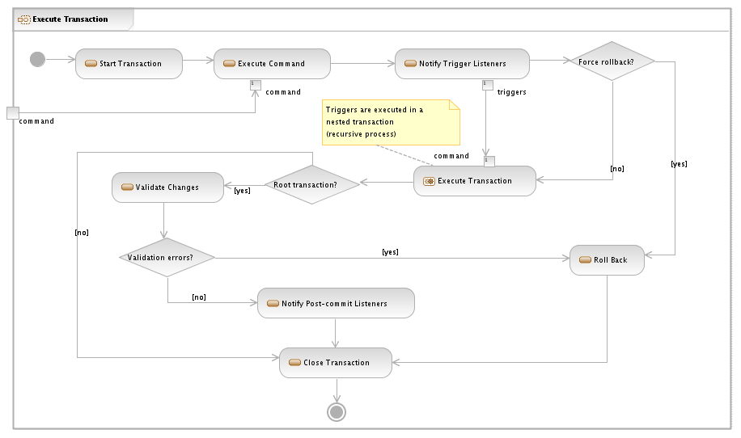
Transaction Lifecycle Overview

Slide 94
Change Listeners
EMF provides an Adapter mechanism to notify listeners when objects change
  In a transactional environment, though, we can end up reacting to changes only to find that they are reverted when a transaction rolls back
Enter the ResourceSetListener
  Post-commit event notifies a listener of all of the changes, in a single batch, that were committed by a transaction
  If a transaction rolls back, no event is sent because there were no changes
    There are exceptions for changes that are not (and need not be) undone, such as resource loading and proxy resolution

Slide 95
Advanced Topics
Generating customized code
Cross-resource containment
XMLResource options
CrossReferencer
Import/Exporter mechanism

Slide 96
Generating Customized Code
The EMF code generator can be customized in various ways to meet the needs of your application
There are different levels of customization
  Generator Options
  Dynamic Templates
  Generator Extension

Slide 97
Generator Options
The EMF code generator provides a number of options which can have a significant effect on the kind of code that is generated from the default templates
  Suppress Interfaces
  Suppress EMF Metadata
  Root Extends Interface
  Suppress EMF Types
  Suppress EMF Model Tags

Slide 98
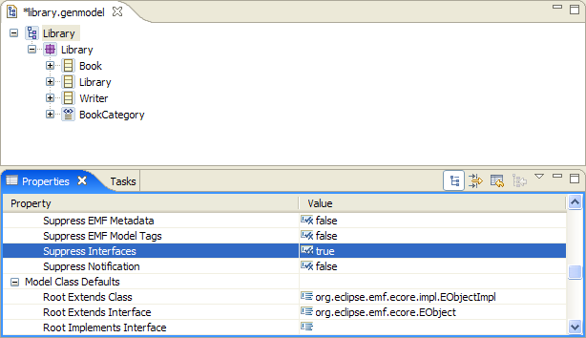
Generator Options
All can be adjusted as properties of the GenModel element, the root object in the generator

Slide 99
Dynamic Templates
The content of the templates used by the EMF code generator can be changed or replaced by enabling dynamic templates
Set the value of the ‘Dynamic Templates’ generator model property to ‘true’
Set the value of the ‘Template Directory’ generator model property to the location of the custom templates
Dynamic templates can be customized in three ways
  Replacement
  Insertions
  Overrides

Slide 100
Template Replacement
Copy default template to the dynamic template directory (with the same name and relative location) and modify as desired
Modified template is compiled dynamically and used in place of the default template
Must keep in sync with changes in default templates (“clone and own”)…
Notes:
Header.javajetinc is an example of a template that should perhaps always be replaced – to contain your copyright.

Slide 101
Template Insertions
Can insert content into default templates via insertion points identified using JET @include directive (fail=“silent”)
Dynamic template includes default template; insertions are included and compiled dynamically, result is used in place of the default template
By convention, insertions are placed in a folder named after the including template and end with a .insert.*jet extension
A number of insertion points have been defined for some commonly customized EMF templates (i.e. Class.javajet, ItemProvider.javajet, TestCase.javajet)
Notes:
Dynamic “placeholder” template can also add required imports for compiling the template (in case the insertions reference new types).
Need to reference default template “container” in JET project settings – i.e. templates;@/org.eclipse.emf.codegen.ecore/templates.

Slide 102
Template Overrides
Can override content of default templates via override points identified using JET @include directive (fail=“alternative”)
Dynamic template includes default template; overrides are included and compiled dynamically, result is used in place of the default template
By convention, overrides are placed in a folder named after the including template and end with a .override.*jet extension
A number of override points have been defined for some commonly customized EMF templates (i.e. Class.javajet, ResourceFactoryClass.javajet, TestCase.javajet)
Notes:
Dynamic “placeholder” template can also add required imports for compiling the template (in case the overrides reference new types).
Need to reference default template “container” in JET project settings – i.e. templates;@/org.eclipse.emf.codegen.ecore/templates.

Slide 103
Template Insertions and Overrides
Simplified example from Class.javajet:
<%@ include file="Class/genOperation.override.javajetinc" fail="alternative" %>
<%@ start %>
public <%=genOperation.getImportedType()%> <%=genOperation.getName()%>(...)
{
<%if (genOperation.hasBody()) {%>
<%=genOperation.getBody(genModel.getIndentation(stringBuffer))%>
...
<%} else {%>
<%@ include file="Class/genOperation.TODO.override.javajetinc" fail="alternative" %>
<%@ start %>
// TODO: implement this method
throw new UnsupportedOperationException();
<%@ end %>
<%}%>
}
<%@ include file="Class/genOperation.insert.javajetinc" fail="silent" %>
<%@ end %>

Slide 104
Generator Extension
EMF’s generator is extensible
  Code generation is performed by visiting the elements in the model and invoking templates to generate artifacts for each element
  Control over this process is delegated to GeneratorAdapters via one or more GeneratorAdapterFactory
  Additional adapter factories can be plugged into the generator to create adapters that generate additional artifacts

Slide 105
Generator Extension
Contributing adapters via an extension point:
Adapters can be added directly, or via an adapter factory
A generic adapter factory is instantiated for each adapter added directly, so it’s more efficient to add multiple adapters via a factory
<extension point="org.eclipse.emf.codegen.ecore.generatorAdapters">
<adapterFactory class="com.example.generator.MyGeneratorAdapterFactory"/>
<adapter modelClass="GenModel"
class="com.example.generator.MyGenModelGeneratorAdapter"/>
</extension>

Slide 106
Generator Model Extension
It is possible, but not advised, to extend the generator model by subclassing its elements
  New attributes can be added to support additional code generation options
  These attributes can be exposed as properties in the generator UI by registering a specialized adapter factory via the org.eclipse.emf.edit.itemProviderAdapterFacotries extension point
  Protected members of GenModel elements are not considered API: you may have to adapt to changes in the base implementation!
A better way to introduce new code generation options is using generator annotations

Slide 107
Advanced Topics
Generating customized code
Cross-resource containment
XMLResource options
CrossReferencer
Import/Exporter mechanism

Slide 108
Persistence and Serialization Review
Serialized data is referred to as a resource
Data can be spread out among a number of resources in a resource set
One resource is loaded at a time, even if it has references to objects in other resources in the resource set
  Proxies exist for objects in other resources
  Lazy or demand loading of other resources as needed
  A resource can be unloaded
Notes:
Initially the arrows are proxies and when the references in Resource1 are resolved, they are replaced by the actual object from Resource2.
The 2nd proxy will be a proxy until it is accessed. When the 1st proxy is resolved Resource2 is loaded into the ResourceSet but that doesn’t resolve all the proxies.

Slide 109
Cross-Resource Containment
Allows an object hierarchy to be persisted across multiple resources
  eObject.eResource() may be different from eObject.eContainer().eResource()
Must be explicitly enabled
  The containment reference has to be set to resolve proxies
  Also, on generated models, the value of the “Containment Proxies” generator model property has to be set to ‘true’

Slide 110
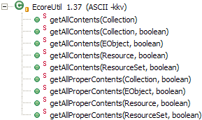
EcoreUtil Methods for Cross-Resource Containment
When the containment tree is spread across multiple files, one may be interested in differentiating the “local” children of an object from children in other resources
The *Proper* methods available in EcoreUtil only deal with the “local” children of a containment tree
All children
Local children
Notes:
Should also mention generated editor support for containment proxies (Control / Uncontrol menu items)…

Slide 111
Advanced Topics
Generating customized code
Cross-resource containment
XMLResource options
CrossReferencer
Import/Exporter mechanism

Slide 112
XMLResource Options
XMLResource offers a set of options that can be used to tweak load and save behavior
The options are passed to the resource’s save and load methods as entries in a map
  The key is the constant that represents the option
  Each option requires an appropriate value

Slide 113
XMLResource Load Options
OPTION_DEFER_IDREF_RESOLUTION
  Option value: Boolean
  Defers resolving references within a resource until the whole document has been parsed
OPTION_USE_PARSER_POOL
  Option value: org.eclipse.emf.ecore.xmi.XMLParserPool
  Provides a parser pool, from which SAXParser instances are created and reused
OPTION_USE_XML_NAME_TO_FEATURE_MAP
  Option value: java.util.Map
  Enables sharing the cache of mappings between qualified XML names (namespace + local name) and corresponding Ecore features across invocations of load(…), or even among resources
Notes:
OPTION_DEFER_IDREF_RESOLUTION
Option value: Boolean
This option can be enabled to defer resolving references within a resource until the whole document has been parsed. The default strategy is to try to resolve each reference as it is encountered and then, at the end, resolve any ones that failed. This wastes time looking up forward references that do not exist yet, which, if you're using intrinsic IDs, can involve iterating over every object in the resource.
OPTION_USE_PARSER_POOL
Option value: org.eclipse.emf.ecore.xmi.XMLParserPool
We strongly encourage to set this option for EMF load operation. This option is used to provide a parser pool, from which SAXParser instances are created and reused. XMLParserPool defines a simple interface for obtaining and releasing parsers based on their features and properties. Specifying a parser pool, such as an instance of the default implementation, XMLParserPoolImpl, can improve performance dramatically when a resource performs repeated loads. A single parser pool can also be shared among multiple resources. Default implementation is also thread-safe.
OPTION_USE_XML_NAME_TO_FEATURE_MAP
Option value: java.util.Map
This option can be used to share the cache of mappings between qualified XML names (namespace + local name) and corresponding Ecore features across invocations of load(), or even among resources. It can take some time to determine these associations, since they can be affected by ExtendedMetaData or an XMLMap, so they are cached during a load. If you use this option to specify the same map for several loads, that instance will be used as the cache, improving the performance for all but the first. You can share a single map among multiple resources, unless they load different models with conflicting qualified names.

Slide 114
XMLResource Load Options
OPTION_USE_CACHED_LOOKUP_TABLE
  Option value: java.util.List
  Specifies a list as a place holder for caching information during the subsequent saving of XML documents
OPTION_USE_DEPRECATED_METHODS
  Option value: Boolean
  Use methods that were deprecated in EMF
  The default value is Boolean.TRUE
Notes:
OPTION_USE_CACHED_LOOKUP_TABLE
Option value: java.util.List
Specify a list as a place holder for caching information during the subsequent saving of XML documents. This option can improve performance for serialization (saving) of multiple XML resources. This option is similar to the OPTION_USE_XML_NAME_TO_FEATURE_MAP which is used for deserialization (loading).
OPTION_USE_DEPRECATED_METHODS
Option value: Boolean
Use methods that were deprecated in EMF. The default value is true. To improve deserialization performance turn this option to false. The methods affected are:
XMLHelper#createObject(org.eclipse.emf.ecore.EFactory, EClassifier)
XMLHander#handleNamespaceAttribs()
XMLHandler#createObjectFromFactory(EFactory factory, String typeName)
XMLLoadImpl#getEncoding()
Note: if you use this option the SAX parser used for parsing documents must be namespace-aware parser, i.e. the namespaces should be turned on for the parser used. The default parser implementation is not namespace-aware. To turn on namespaces, either use OPTION_USE_PARSER_POOL or overwrite XMLLoadImpl#makeParser()

Slide 115
XMLResource Save Options
OPTION_FLUSH_THRESHOLD
  Option value: Integer
  Specifies a maximum number of characters to allow in the output stream before flushing it
OPTION_USE_CACHED_LOOKUP_TABLE
  Option value: java.util.List
  Provides a placeholder to cache information about structure of the model (using qualified XML names as a key for caching information)
OPTION_CONFIGURATION_CACHE
  Option value: Boolean
  Enables caching and reusing generic data in repeated save operations, avoiding the cost of reinitializing the data
Notes:
OPTION_FLUSH_THRESHOLD
Option value: Integer
This option can be used to specify a maximum number of characters to allow in the output stream before flushing it. This reduces the memory used in serializing a large file, but it is slower than the default behavior.
OPTION_USE_CACHED_LOOKUP_TABLE
Option value: java.util.List
This option provides a placeholder to cache information about structure of the model. (using qualified XML names as a key for caching information). When possible, the same placeholder list should be shared among resources, unless you intent to serialize instances of different models.
OPTION_CONFIGURATION_CACHE
Option value: Boolean
This option can be enabled to cache and reuse generic data in repeated save operations, avoiding the cost of reinitializing the data. This option is save to use when serializing instances of the same model.

Slide 116
XMLResource Save Options
OPTION_FORMATTED
  Option value: Boolean
  Disables formatting of documents, omitting whitespaces and line brakes, to improve the performance of saving and, subsequently, loading the resulting document
OPTION_USE_FILE_BUFFER
  Option value: Boolean
  Enables accumulating output during serialization in a temporary file, rather than an in-memory buffer
Notes:
OPTION_FORMATTED
Option value: Boolean
This option is used to disable formatting of documents, omitting whitespaces and line brakes, to improve the performance of saving and, subsequently, loading the resulting document. This means fewer bytes have to be written and read, but the serialization will be less human-readable.
OPTION_USE_FILE_BUFFER
Option value: Boolean
This option can be enabled to accumulate output during serialization in a temporary file, rather than an in-memory buffer. This reduces the memory used in serializing a large file, but it is slower than the default behavior.

Slide 117
Advanced Topics
Generating customized code
Cross-resource containment
XMLResource options
CrossReferencer
Import/Exporter mechanism

Slide 118
Using a CrossReferencer
Dynamically computes a map with the target object and the list of settings that “refer” to it
  This computation may be a long operation depending on the number of objects
The map represents a snapshot of the state of the objects
  As the objects change, the settings’ values may become inconsistent with the map
Requires a context to compute the map
  The context can be a collection of EObjects, a resource, or a resource set, or a combination of these
  Objects that are not in the scope of the context won’t be available in the map

Slide 119
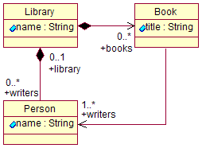
Using a CrossReferencer
{
Library library = LibFactory.eINSTANCE.createLibrary();
Book book = LibFactory.eINSTANCE.createBook();
book.setTitle("EMF");
Person dave = LibFactory.eINSTANCE.createPerson();
library.getBooks().add(book);
library.getWriters().add(dave);
book.getWriters().add(dave);
Map<EObject, Collection<EStructuralFeature.Setting>> map =
EcoreUtil.CrossReferencer.find(Collections.singleton(library));
Collection<EStructuralFeature.Setting> settings = map.get(dave);
if (settings != null)
{
for (EStructuralFeature.Setting setting : settings)
{
if (setting.getEObject() == book &&
setting.getEStructuralFeature() == LibPackage.Literals.BOOK__WRITERS)
{
System.out.println("Found it. The book is \"" + book.getTitle() + "\"");
}
}
}
}
Found it. The book is "EMF"
Notes:
The question we want to answer is: what books were written by Dave?
We could also use the UsageCrossReferencer…

Slide 120
Advanced Topics
Generating customized code
Cross-resource containment
XMLResource options
CrossReferencer
Import/Exporter mechanism

Slide 121
Importers and Exporters
UML
Java
model
XML
Schema
Annotated
Java
Java
model
Java
model
EMF
XML
Schema
Java
model
Model Importer
Model Exporter
XML
Schema
for XMI
Java
model
?
?
Java
model
Java
model
Ecore
Java
model
Notes:
Every solid box in this picture represents a way to describe a modeled domain.

Slide 122
Contains material from “Effective Use of the Eclipse Modeling Framework”, Christian W. Damus, Kenn Hussey, Ed Merks and Dave Steinberg, EclipseCon 2007, licensed under the EPL 1.0

Slide 123
XML Processor
Simplified API for loading and saving XML
  Handles resource set, registries, etc. under the covers
Can automatically create a dynamic Ecore representation of a schema
  Load/save instance documents without generating code
  Manipulate the objects using reflective EObject API
URI schemaURI = ...
String instanceFileName = ...
XMLProcessor processor = new XMLProcessor(schemaURI);
Resource resource = processor.load(instanceFileName, null);
EObject documentRoot = resource.getContents.get(0);

